Slide 1

Centralized
Motion Planning for Autonomous Vehicles in a City Grid
Rushikesh Deshmukh
Piyush Malpure
Harin Vashi

Slide 2
Concept
Over this decade, Autonomous Vehicles (AVs) are going to become increasingly predominant
Traffic Management for AVs allows for coordinated control of the traffic
There are motion planners for individual AVs that can plan trajectories from a start to end point and there are collision detection and avoidance systems in place that perform local planning
These are not sufficient or sophisticated enough to coordinate their motion when interacting with multiples AVs.
This leads to suboptimal trajectories, deadlocks, or mismanagement of Emergency vehicles
Instead of using red lights at intersections, we vary the paths and velocities to avoid vehicles coming together
Notes:
Currently Autonomous Vehicles have their individual motion planners and collision detection and avoidance systems. They plan their trajectories from start to end and all the computation is performed locally. These systems are viable currently because not all vehicles are autonomous, but once all the vehicles on our roads become autonomous, there will be a need for a more sophisticated system. This can provide a faster, safter, more efficient path for all the vehicles. Such systems can also currently be found in modern Multi-Robot autonomous warehouses used by companies like Amazon.
Change Audio

Slide 3
Methods
Desired Features:
Optimal Motion Planning for multi-robot systems (AVs)
Avoidance of deadlock situation and easy traffic flow through the city grid
Prioritization for emergency vehicles
Assumptions:
All roads are bidirectional
Vehicles have discreet speed levels
Vehicles have a limited fuel level, which reduces as per the length of the path

Slide 4
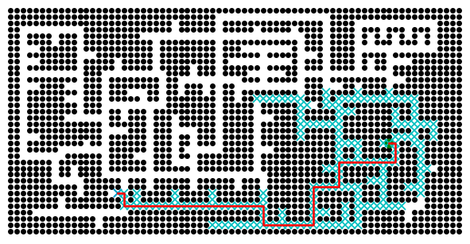
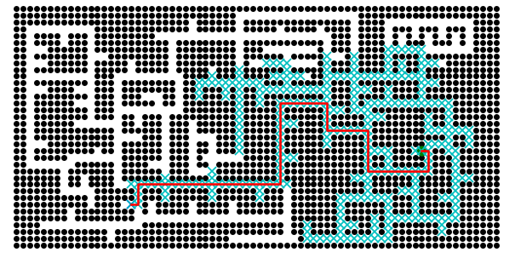
Modified A*
Notes:
Naive Centralized planner:
The Naive planner acts as a baseline to compare the performance of the algorithms. In this algorithm the centralized planner does not check for collisions and take any preventive measures for solving any conflicts. It uses an A* algorithm to plan paths for multiple cars.
Centralized planner with prioritized safe-interval planning:
This planner reduces the velocity of the obstacles when the cars are on the path to collision. It showed better performance than the Naive algorithm with lesser collisions and more cars reaching safely home.
Combinational Centralized planner with prioritized safe-interval and path recalculation:
This planner reduces velocity and if necessary recalculates the whole path so that there is no collision. This algorithms is the most efficient algorithm. With very less collisions even when the traffic is very high.

Slide 5
Centralized Planner
Path Generated by Naïve A* algorithm
Central Planner checks for collision
Car node spawns a new Car
If collision: use prioritized safe interval planning
Check for collision again
If collision: use path recalculation algorithm
Send the path to Car node
3 approaches are implemented:
Naïve Centralized Planner
2. Centralized planner with prioritized safe-interval planning
3. Combinational Centralized planner with prioritized safe-interval and path recalculation
Notes:
Naive Centralized planner:
The Naive planner acts as a baseline to compare the performance of the algorithms. In this algorithm the centralized planner does not check for collisions and take any preventive measures for solving any conflicts. It uses an A* algorithm to plan paths for multiple cars.
Centralized planner with prioritized safe-interval planning:
This planner reduces the velocity of the obstacles when the cars are on the path to collision. It showed better performance than the Naive algorithm with lesser collisions and more cars reaching safely home.
Combinational Centralized planner with prioritized safe-interval and path recalculation:
This planner reduces velocity and if necessary recalculates the whole path so that there is no collision. This algorithms is the most efficient algorithm. With very less collisions even when the traffic is very high.

Slide 6
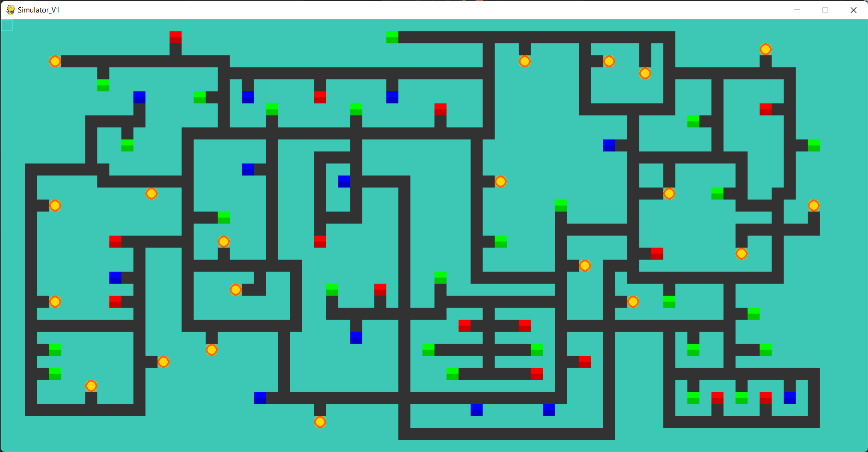
Simulation Environment
Notes:
The simulation environment was developed using pygame. The green yellow blue and red nodes are houses and factories which act as a start or goal point for a car. Cars randomly generate from them and terminate at them. This simulation environment works seamlessly to take input for multiple cars and give a dynamically changing simulation as required for our project. The gray lines represent the routes which are two way. The routes are designed in a way that there are multiple intersections and possibilities for collisions which enables check the efficiency of the algorithms designed.

Slide 7
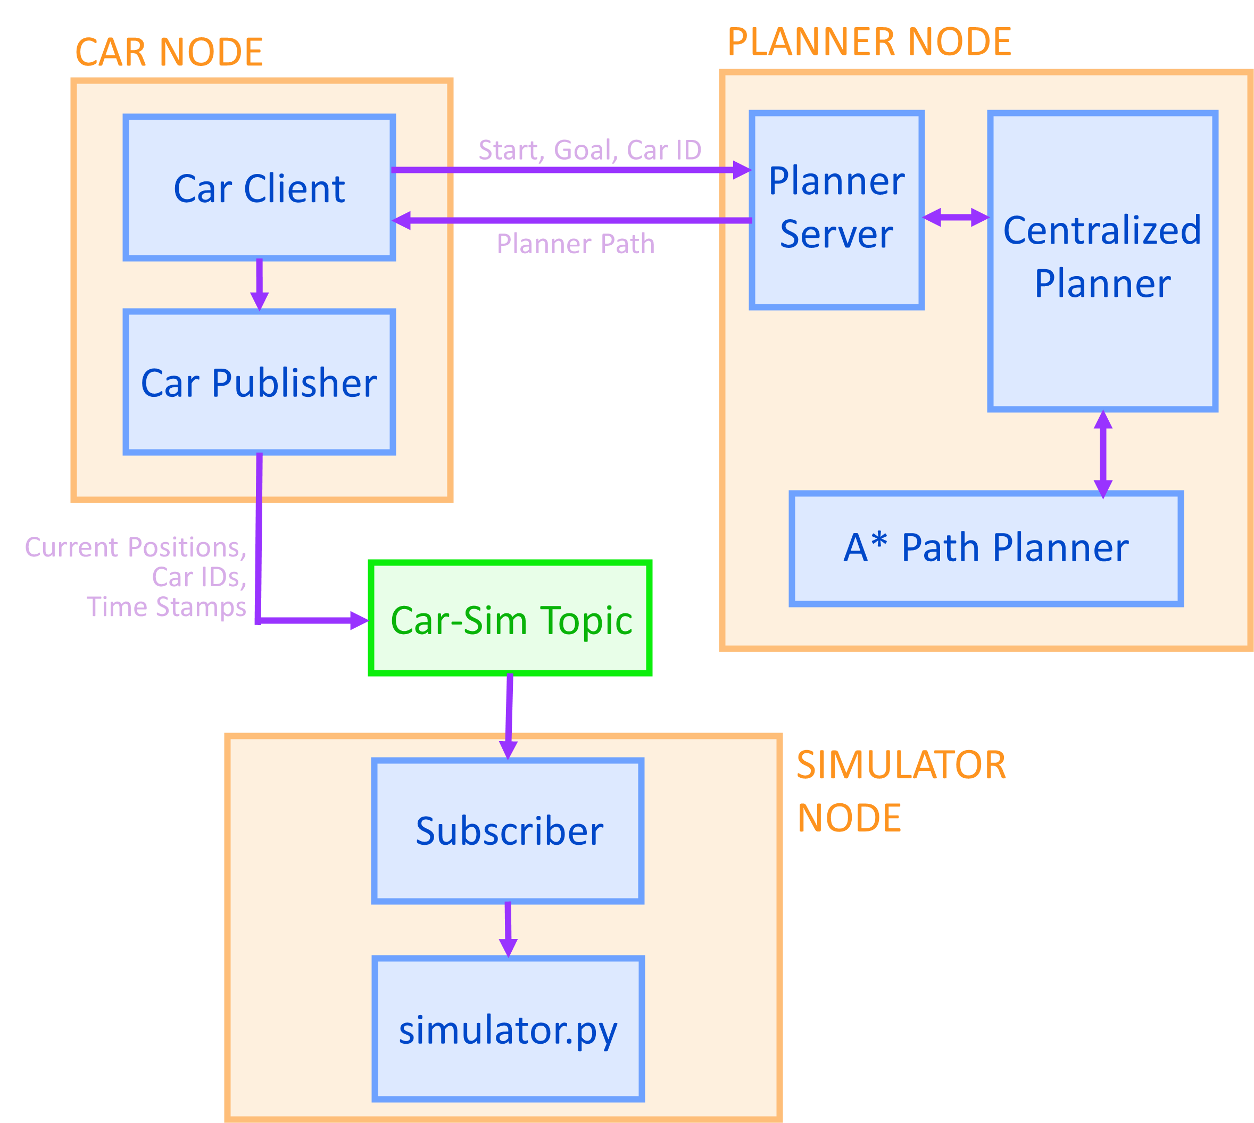
ROS Structure
Notes:
There are 4 main components to the ROS structure.
Planner Server
Car Client
Car Publisher
Simulator Subscriber
The planner server gets the start and goal destination from the car node, it is then passed on to the centralised path planner which keeps track of the cars and their positions, as described above.
It further generates the whole path from the A* Path planner.
It returns the path to the car node which requested the path.
Every car has a node created with at a random time, the car node acts as a client to the planner server, sending it the start node and required goal node with its ID, and receives the path planned from the global planner. Using the local planner it further traverse in the environment and publishes the current positions at each time step with car ID to the topic car\_simulator. Further once the car has reached its destination without collision or encounters a collision the same information is passed to the centralised planner using a car\_status topic.
The Simulator node subscribes to the car\_simulator topic on which every car publishes its current position and ID, using the car IDs it simulates each and every car in the simulator environment.

Slide 8
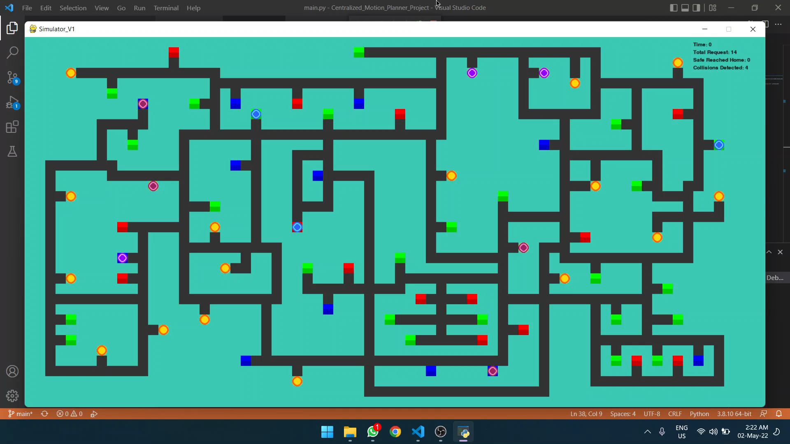
Results - Naïve

Slide 9
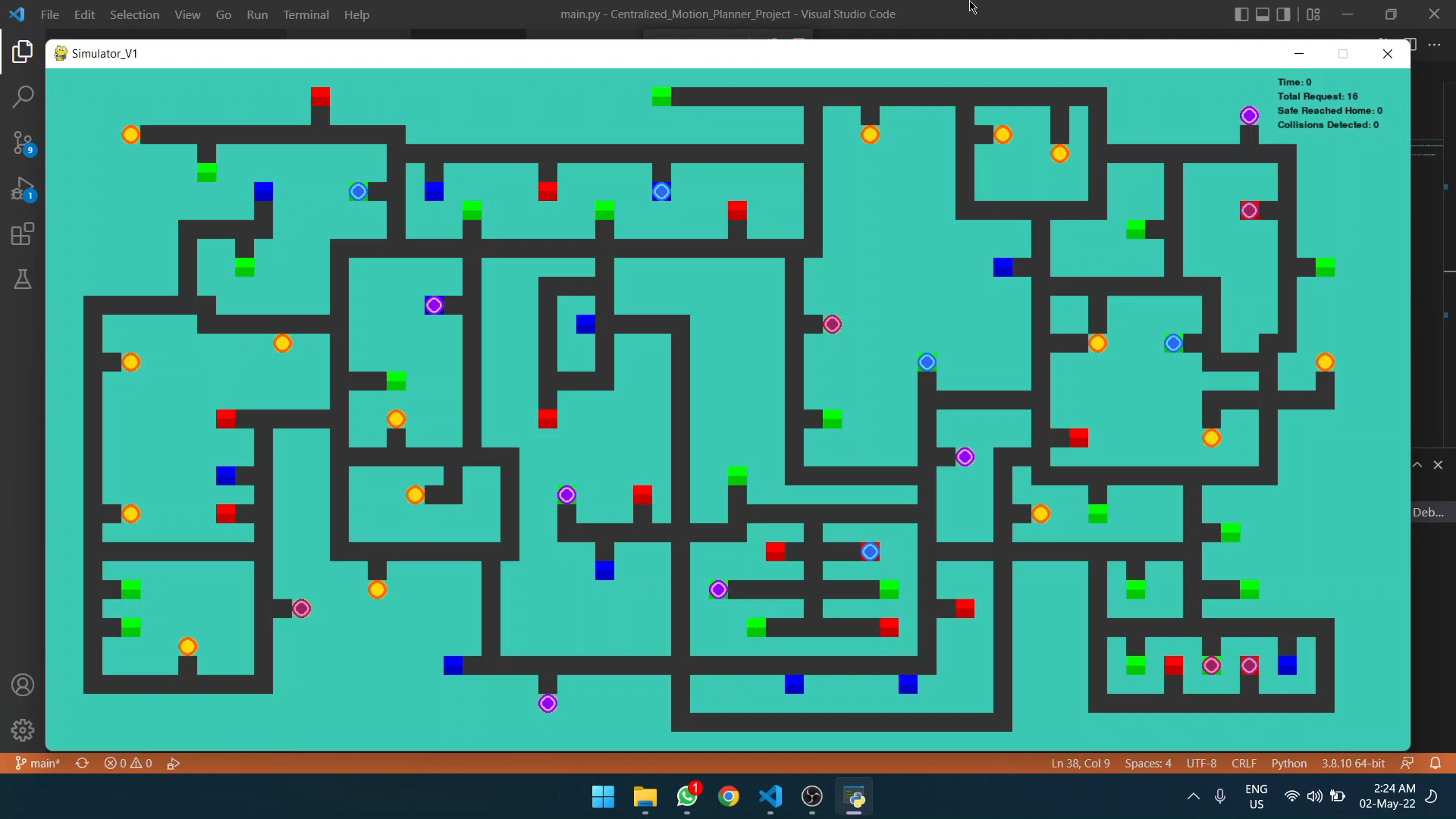
Results - PSIP

Slide 10
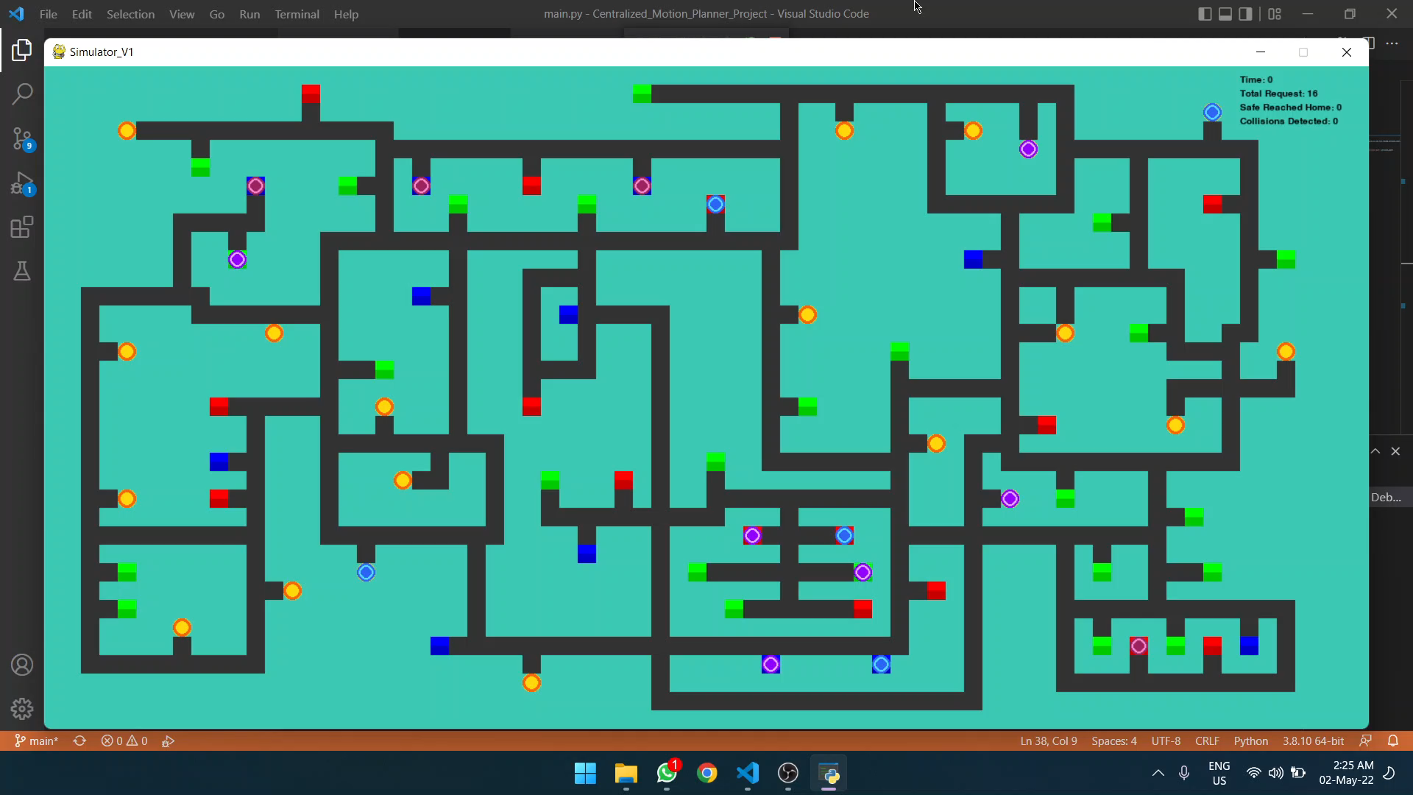
Results - Combinational Planner

Slide 11
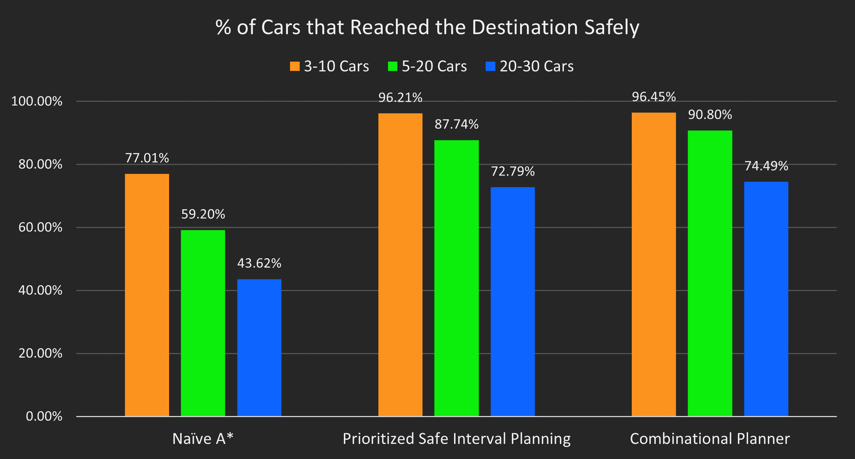
Performance

Slide 12
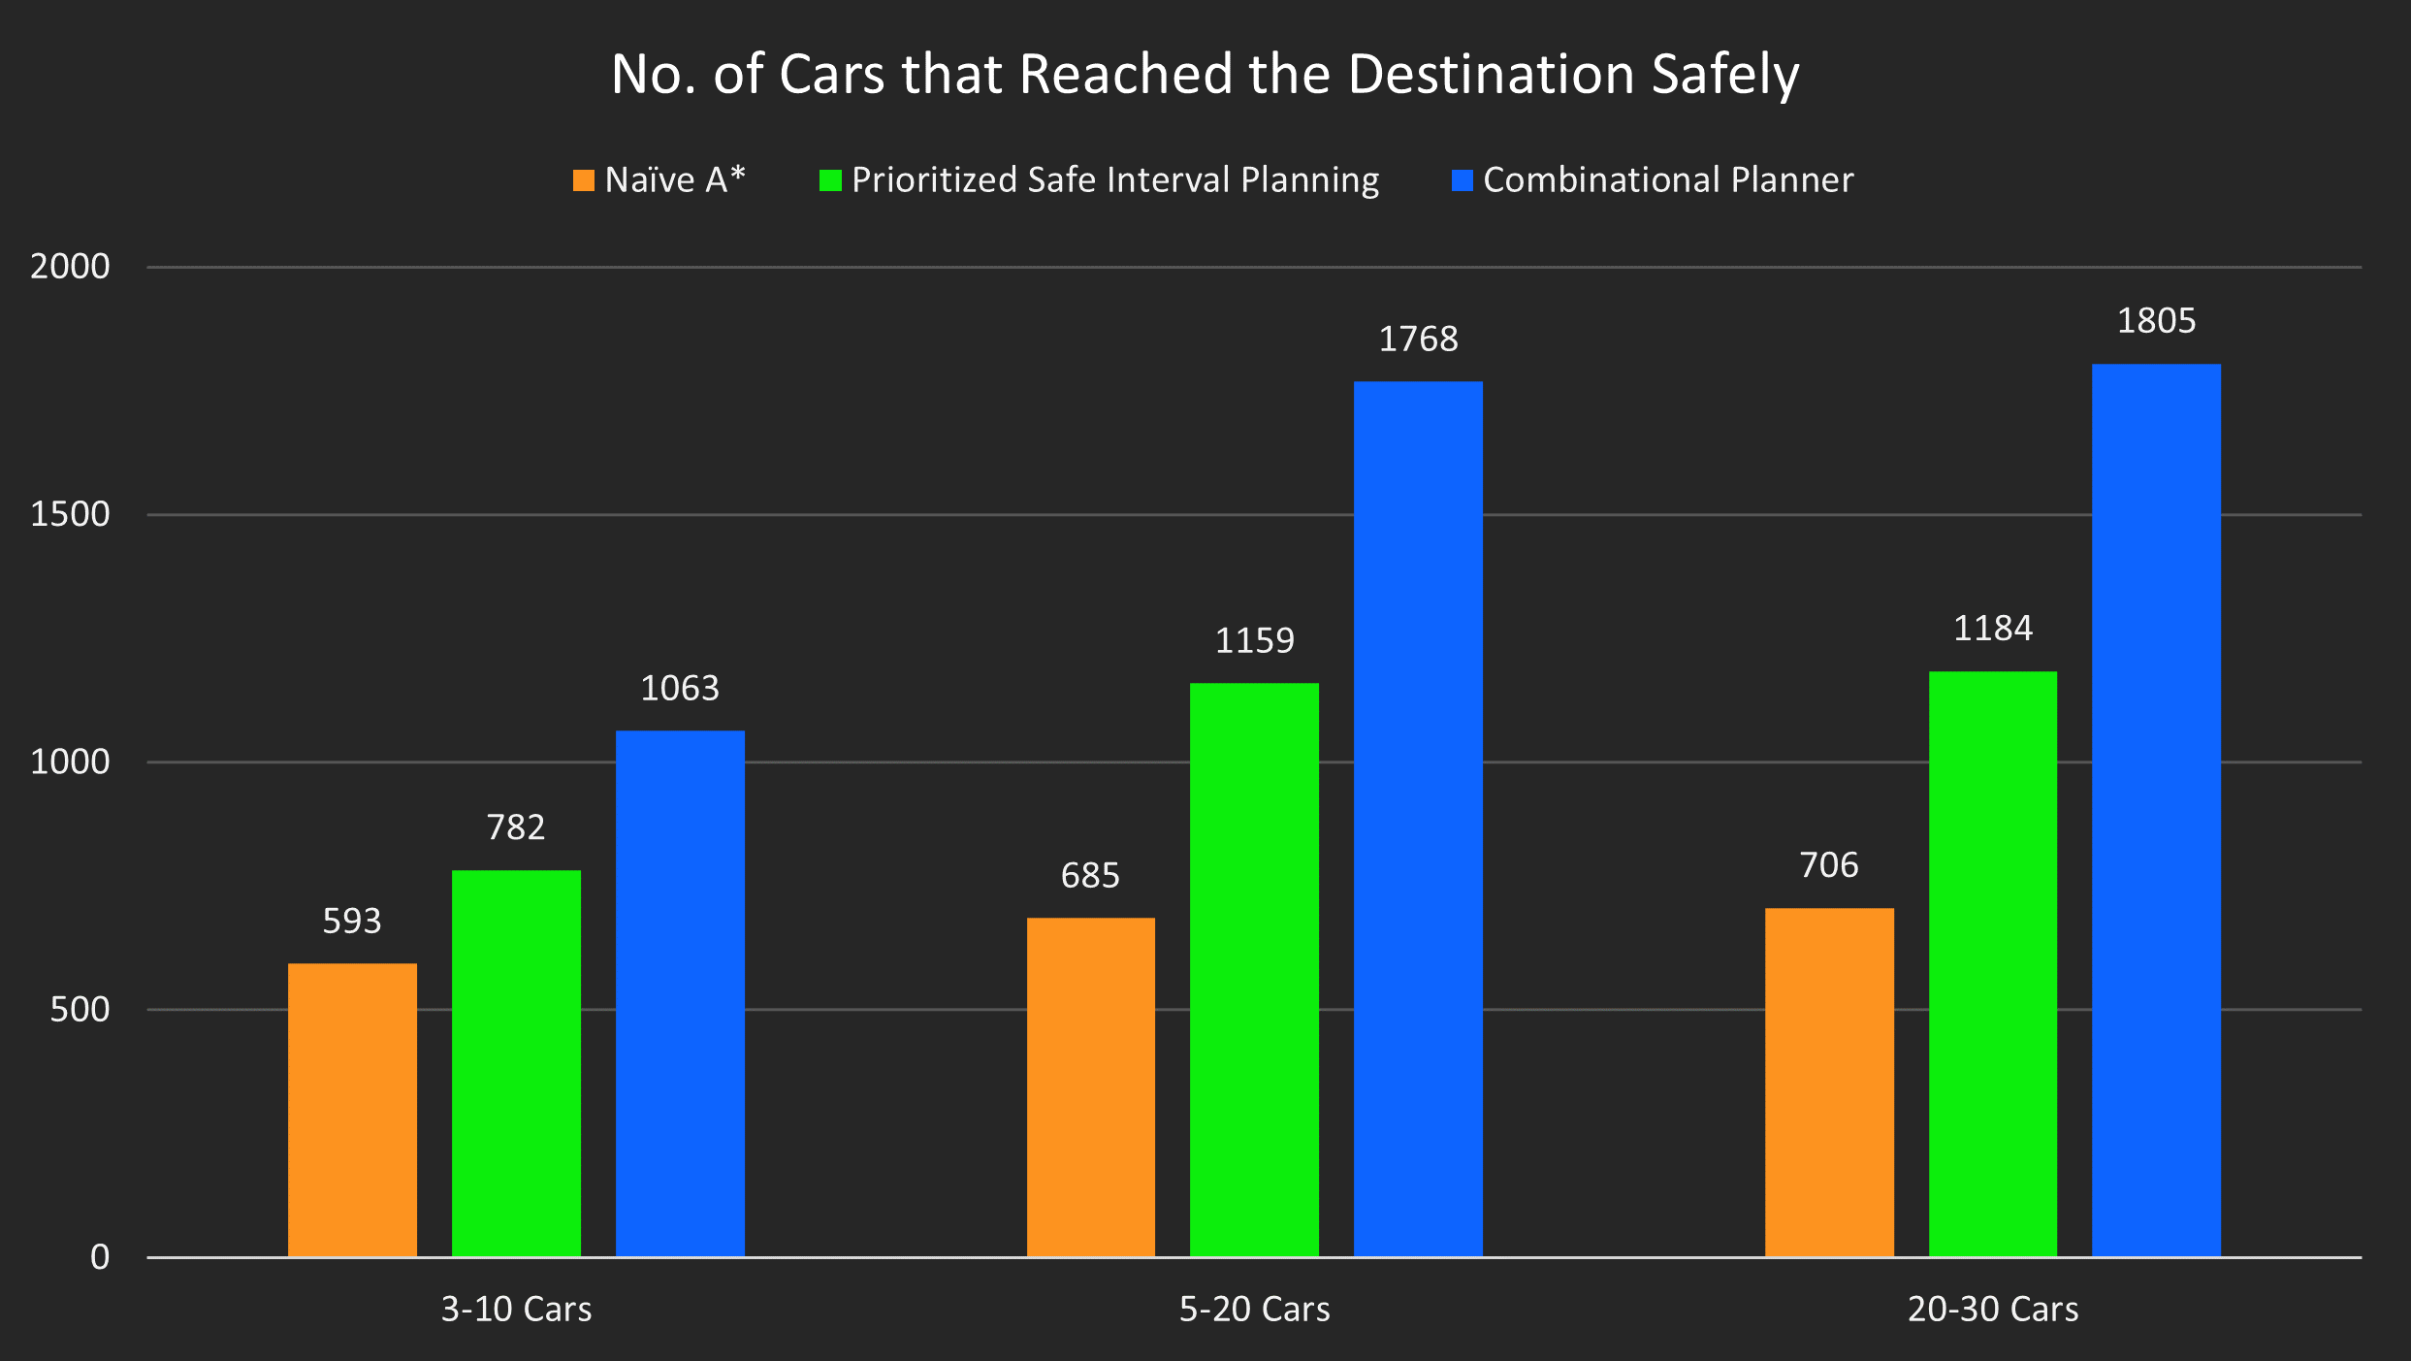
Performance

Slide 13
Discussion
Prioritized Safe Interval Planning works just as good as Combinational Planning Algorithm, and it doesn't change the optimal path. It fails to avoid head-on collision.
Combinational Planning algorithm is computationally heavy and is needed just in case of head-on collision. It finds alternative path that is suboptimal.
The centralized planner designed here finds whole path in one go and this method has a lot of limitations on expansion. As the traffic flow increases, handling and planning the whole path is computationally heavy. Instead, if path is planned in sections of fixed small duration would work better.
This project will benefit from exploring metaheuristic algorthims like PSO, GW algorithm,etc because metaheuristic algorithm takes priority, fuel level, speed, time spent on road to find the optimal solutions for all.
Notes:
Mention here why PSO was not tried

Slide 14
Thank You!
TL;DR: Cars go vroom; they no go boom

